Slide 1

ES3H3 Group 10
Marcel Afunyah, Oliver Tansley, Mahbubah Durojaiye , Liu Zhanwei, Teesha Roy

Slide 2
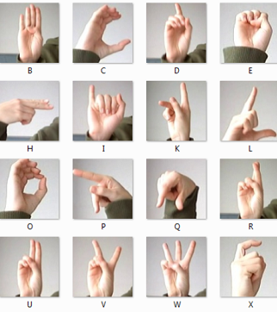
Detecting ASL Hand Gestures
Detecting the Letters of the American Sign Language (ASL) Gestures
Performance accuracy: ~98%
Excluding similar letter/patterns

Slide 3
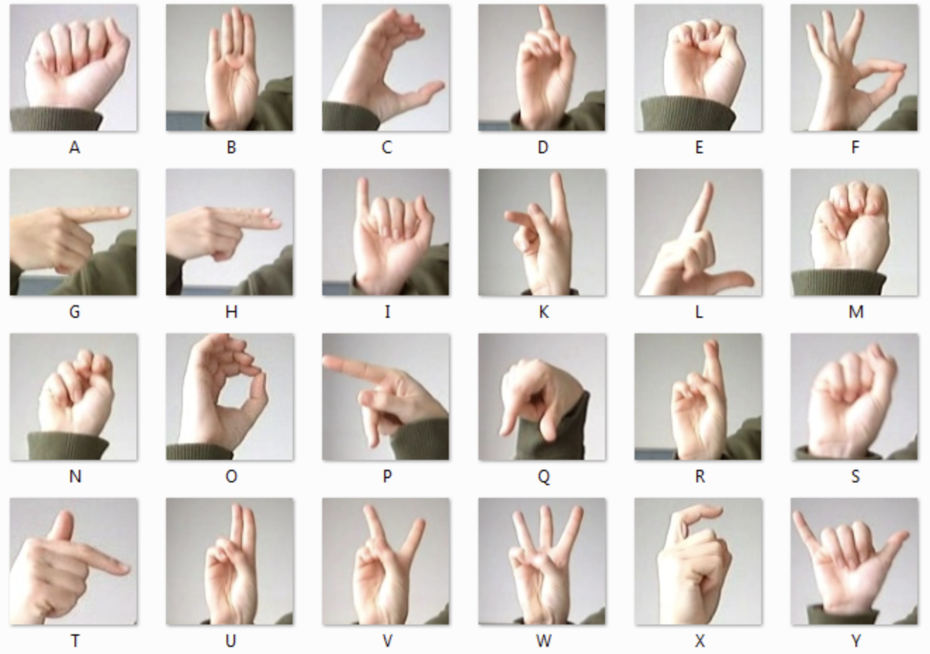
Dataset Decision
The American Sign Language (ASL) Hand gestures provides a good example of varying signs suitable to prove the efficiency of an ‘Intelligent System’
24 signs in total – J and Z have been excluded, as they contain movement
Difficulty might arise in detecting similar characters such A-E-S-M

Slide 4
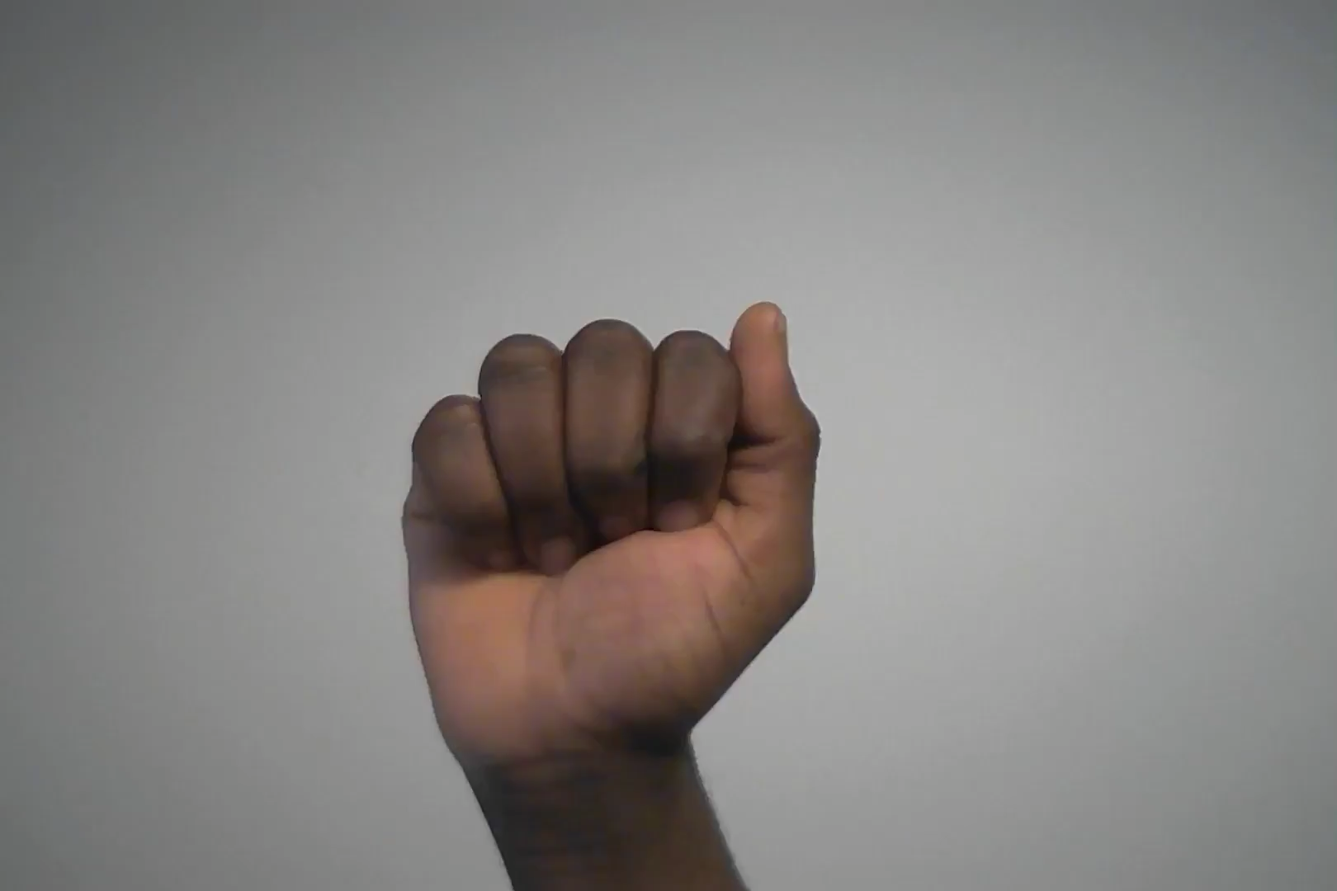
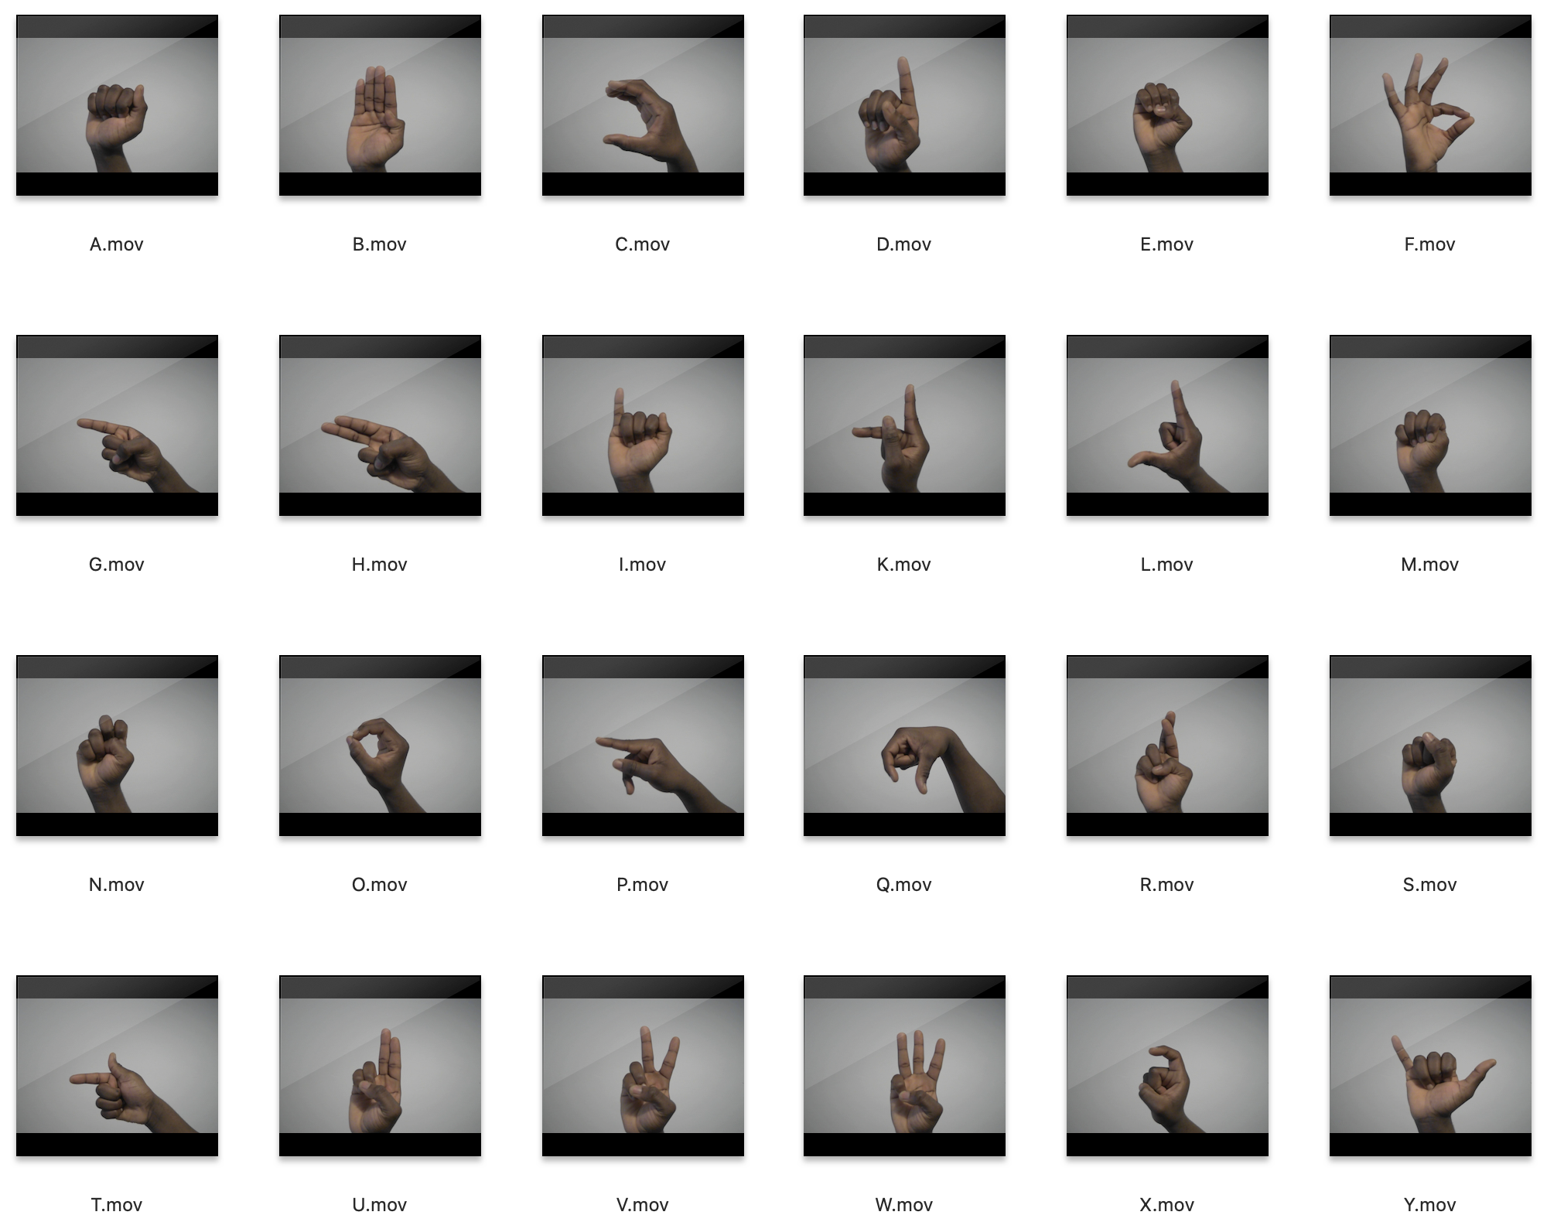
Data Collection
Videos of length ~8 seconds were recorded for each letter
Slight variations: Rotation, arm-hand ratio

Slide 5

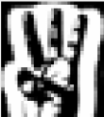
Data Processing
Frames from each video were processed
Image data stored according to chosen ‘Processing Functions’
Processing Functions are applied to the Network inputs before training and testing
Examples: Full Frame with Edge Detection, Resized and Padded with Binary Mask

Slide 6
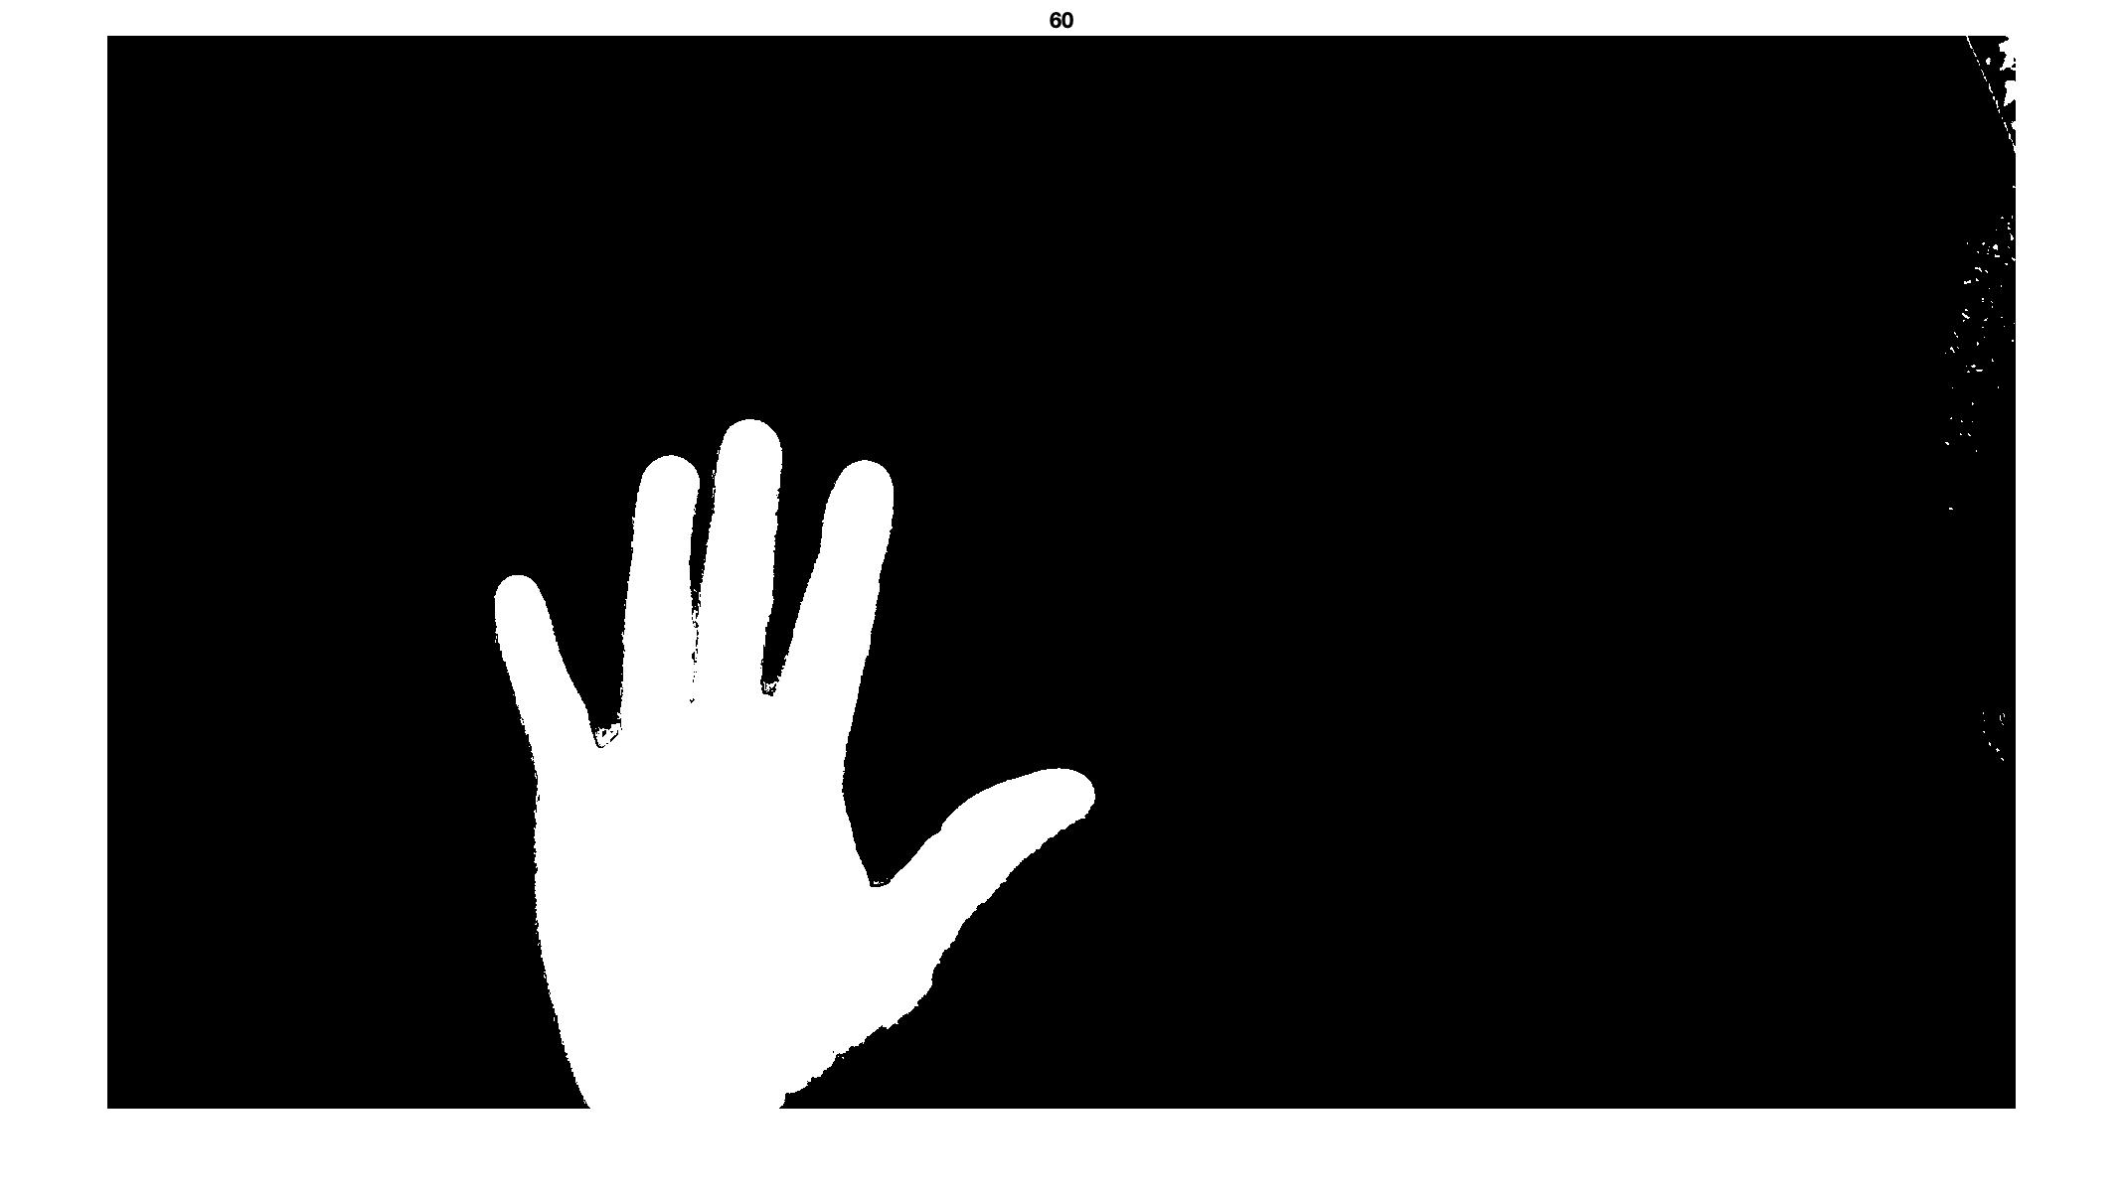
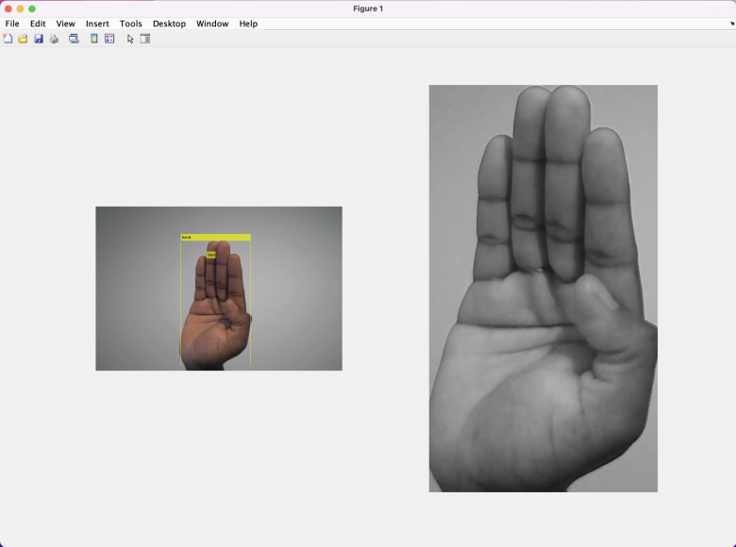
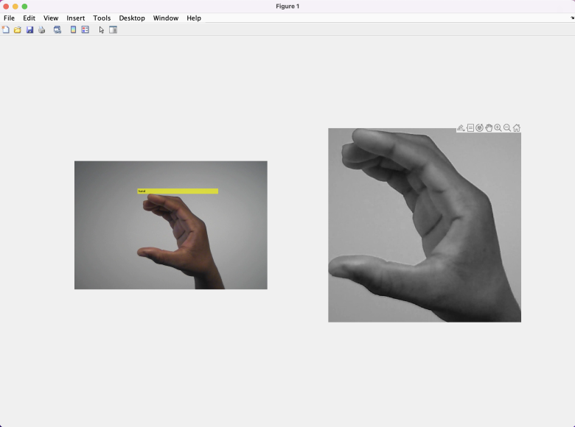
Data Processing – Hand Detection
Hand Detection works as a ‘Pre-Feature Extraction’ for the neural networks.
Proves to be more efficient – Network focuses on hand
A form of noise removal
Methods
Colour Thresholding – Using skin tone
Colour Thresholding – Using imbinarize
The masks produced are used with blobAnalysis to extract the detected hand
Considerations: Different skin tones, contrasting backgrounds

Slide 7
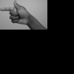
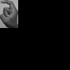
Data Processing – Resizing and Padding
Different gestures have different sizes and aspect ratios (T is ‘wider’ than X)
For certain Processing Functions, images are scaled down to a set height
The width is calculated automatically
Padding is applied to ensure each image reaches the desired dimension
Exceptions: Full Frame functions

Slide 8
Data Processing – Results
The preferred format – ImageDatastore
A folder per letter with files containing processed images, stored as an ImageDatastore
Training_images/
A/
1.png
2.png …
B/
3.png
4.png…
…
Y/
419.png
420.png

Slide 9
What methods did we consider?
Patternnet – produces very strong training results but fails to meet the same standard for testing data
•Newpnn – produced the worst performance of all considered methods, models take extremely long to train (up to 4h)
•Convolutional neural network – produced the best performance, required tuning of many parameters making the optimal result hard to find

Slide 10
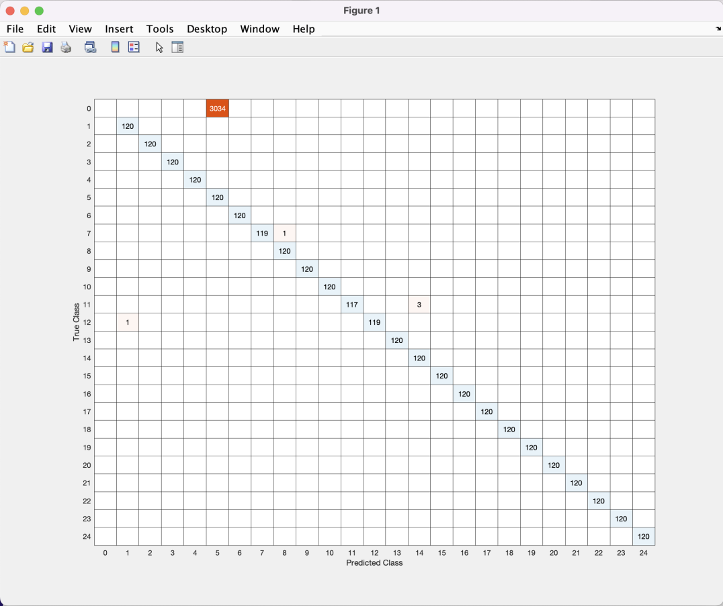
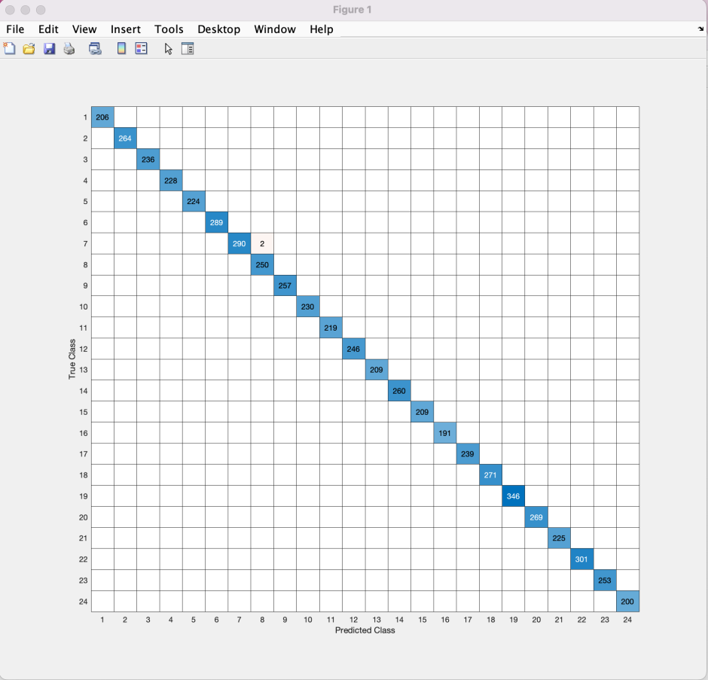
Training Pattern Recognition Network
Fig 1.
Fig 2.
Fig 1. – Confusion matrix for two hidden layers sizes 30; Accuracy: ~48%
Fig 2. – Using all frames (samples) Accuracy ~99% (overfitting)

Slide 11
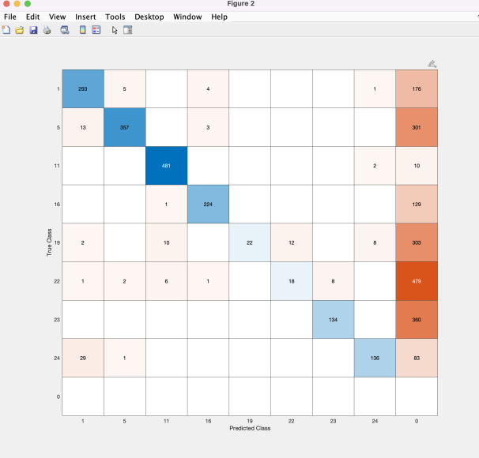
Testing Pattern Recognition Network
Using separate testing data
Accuracy: ~46%

Slide 12
Why convolutional neural network?
The convolutional layers of the network can reduce the dimensionality of the data, without losing significant information.
This is done through applying a weighted sum slider to the image data
This makes the training, and execution of the network more efficient for image processing which typically has very high dimensions
120x120 possible dimensions in our case

Slide 13

Different Network Layers

Slide 14
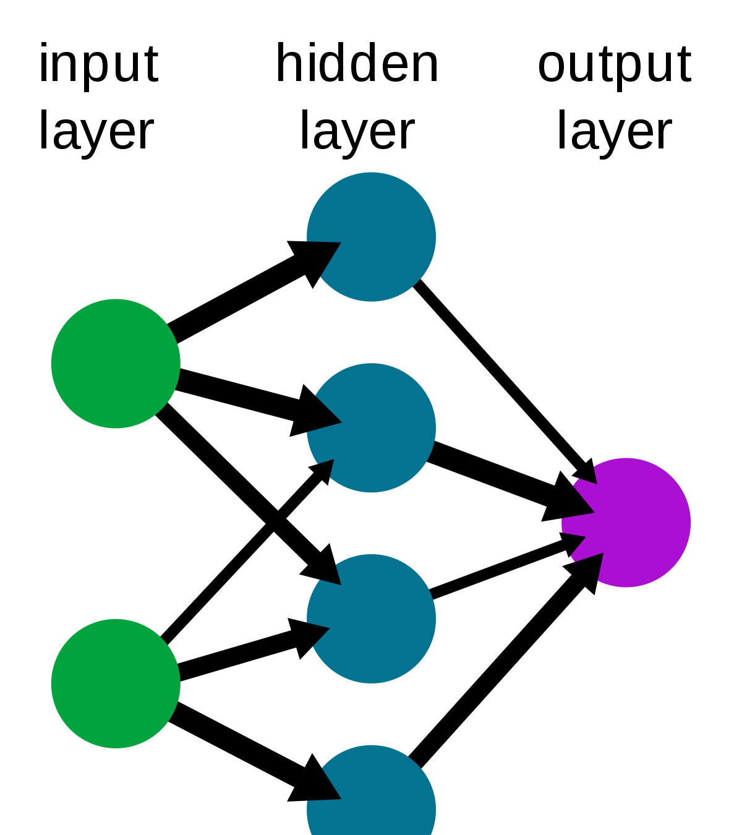
Convolutional layer
The convolutional layer determines the weighted sum of a specified number of pixels and passes these onto the next layer
The rate at which this weighted sum traverses through the pixel data is indicated by the stride length.
A stride length of 2 indicates the average sum window moves by two pixels each time.

Slide 15
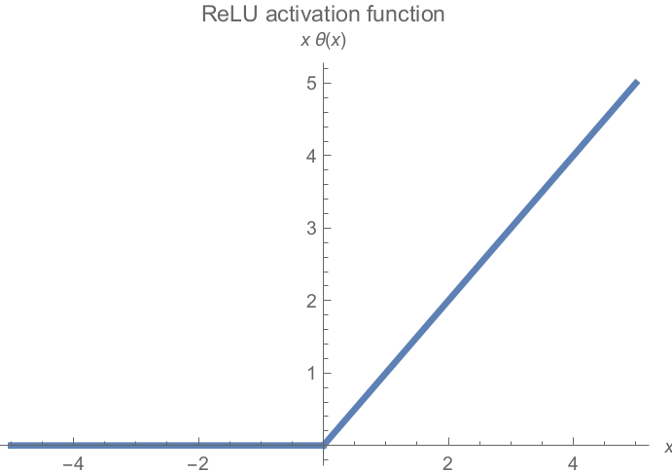
The ReLu Layer
The Relu activation function is the most popular
Sets the value returned by a node to 0 if it is below zero, else it returns the nodes value
The vanishing gradient problem experienced by the hyperbolic tangent and sigmoid function makes Relu a better option where updates to the neural network become insignificant as the gradient of the activation function decreases

Slide 16
Maxpooling Layer
The purpose of the maxpooling layer is to take the most important features of the input and output these to the next layer.
The difference between this and convolution is that this layers output is not sensitive to the location of the feature within the input, reducing this sensitivity makes the network more robust

Slide 17
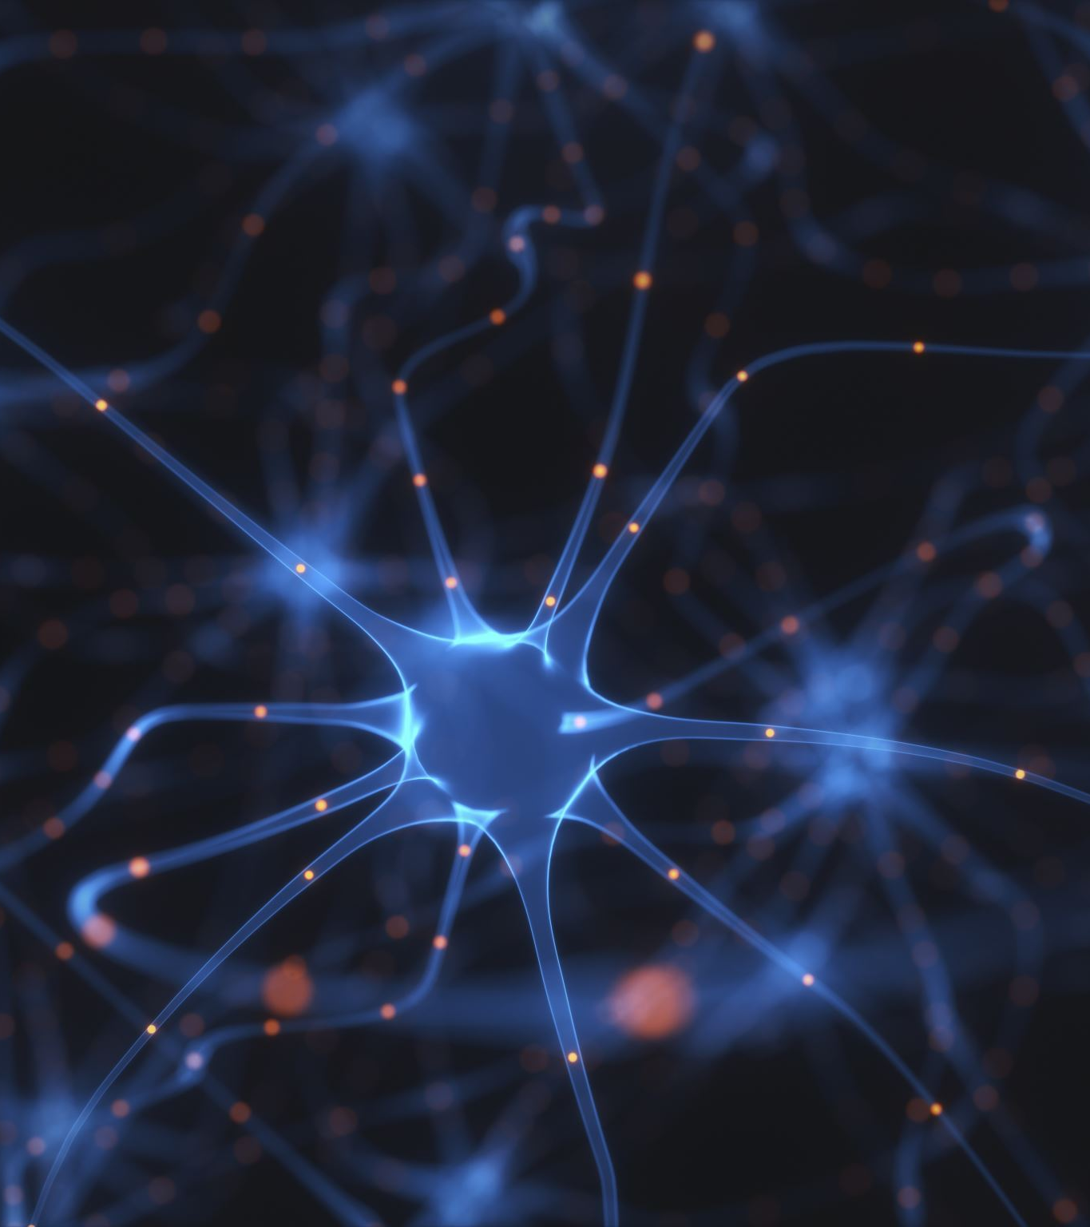
The Dropout Layer
The purpose of this layer is to ‘nullify’ the output of random neurons with a given probability
This ensures that the network does not overfit to minor details that are picked up from the output of the previous layer
Making data associated to classes in the network more generic makes the predictions more robust to minor irrelevant changes in input

Slide 18
Training Settings
Solver – The method in which network parameters are updated, (e.g., gradient descent, ADAM, rmsprop)
Initial learning rate – value between 0-1 which indicates how quickly weights within the network are adapted each time an incorrect prediction gets made during training
Max epochs – The maximum number of times the training dataset will be passed to the model to train it
Minibatch size – The number of unique inputs passed to the network during one epoch smaller than the actual training dataset

Slide 19
Testing
Validation results are a good indicator for overall accuracy (Mostly 70% datasplit)
Static Testing – Separate testing data collected and processed at the same time as the initial training data. Suitable for network input
Static Testing mostly provided accuracy levels around 67-75% (random nature due to shuffling)
Live Testing – Live webcam input

Slide 20
Final Product
Stored a network for each processing function during a training session
The Classifier Script allow for more than one network to be tested at a time
Live Testing works better; giving the chance to adjust the hand to obtain the expected results
Disadvantage of reliance on live testing – unrealistic, requires human knowledge to adjust
Suitable for this purpose

Slide 21
Difficulties, Considerations, Conclusions
Contrasting backgrounds for masks
Dealing with different skin tones
Considered feature detection (SURF, ORB etc) - unreliable
Similarities between certain letters
Image Pyramid Scaling

Slide 22
Alternative Methods
Harris Feature Detector
Histogram of Oriented Gradients (HOG)
SURF Feature Detection

Slide 23
Live Demo

Slide 24
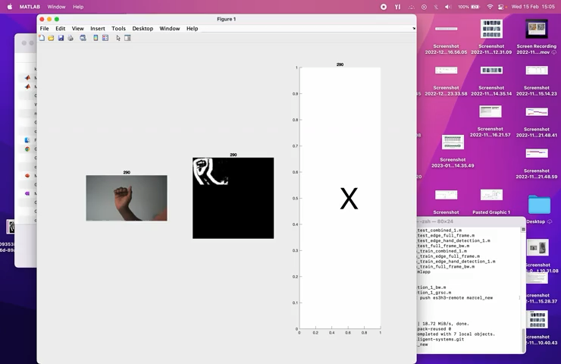
Demo Video
Early version with outdated user interface *

